Slide 1

Basics of
Web Design
Copyright © 2016 Pearson Education, Inc., Hoboken NJ

Slide 2
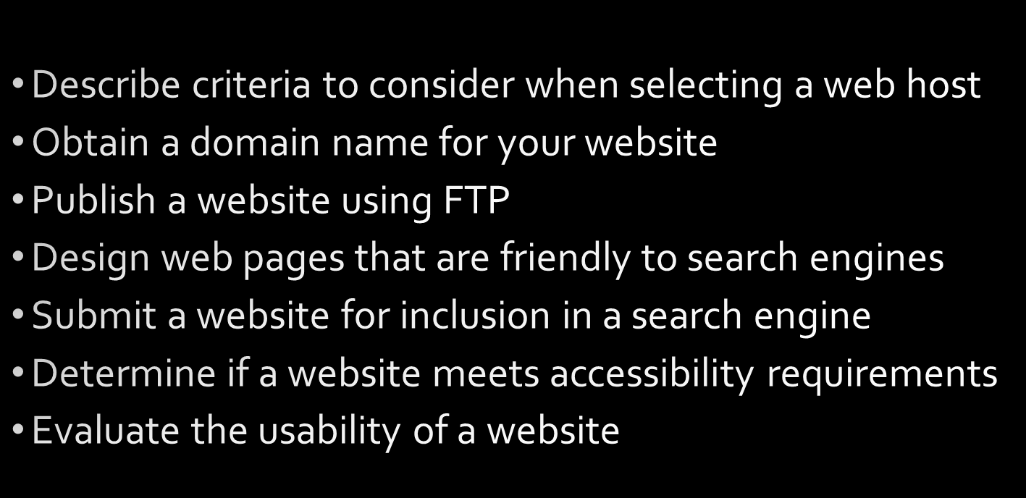
Learning Outcomes
Copyright © 2016 Pearson Education, Inc., Hoboken NJ

Slide 3


Domain Names
Copyright © 2016 Pearson Education, Inc., Hoboken NJ

Slide 4

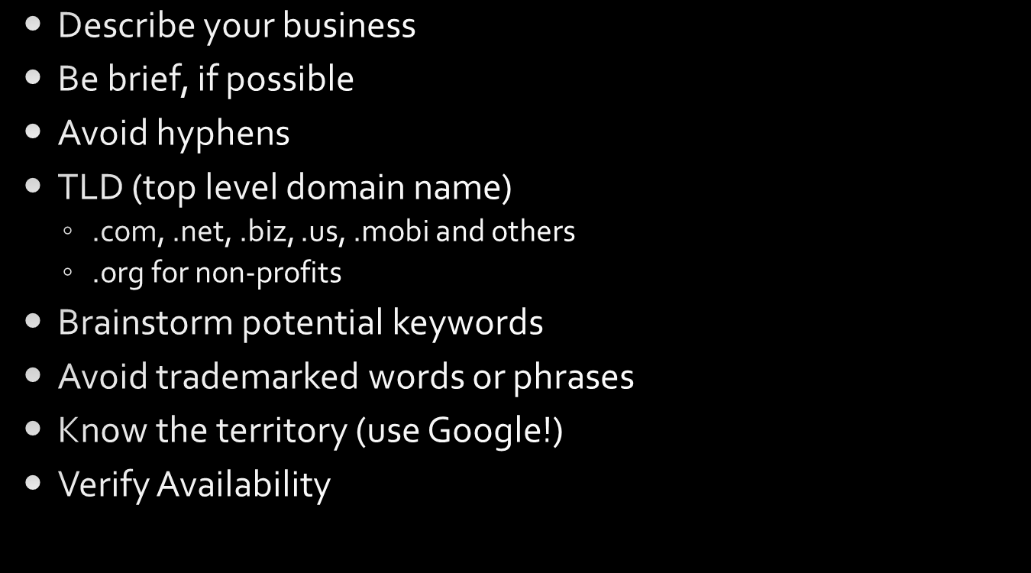

Choosing a Domain Name
Copyright © 2016 Pearson Education, Inc., Hoboken NJ

Slide 5


Registering a Domain Name
Copyright © 2016 Pearson Education, Inc., Hoboken NJ

Slide 6

Web Hosting
Copyright © 2016 Pearson Education, Inc., Hoboken NJ

Slide 7
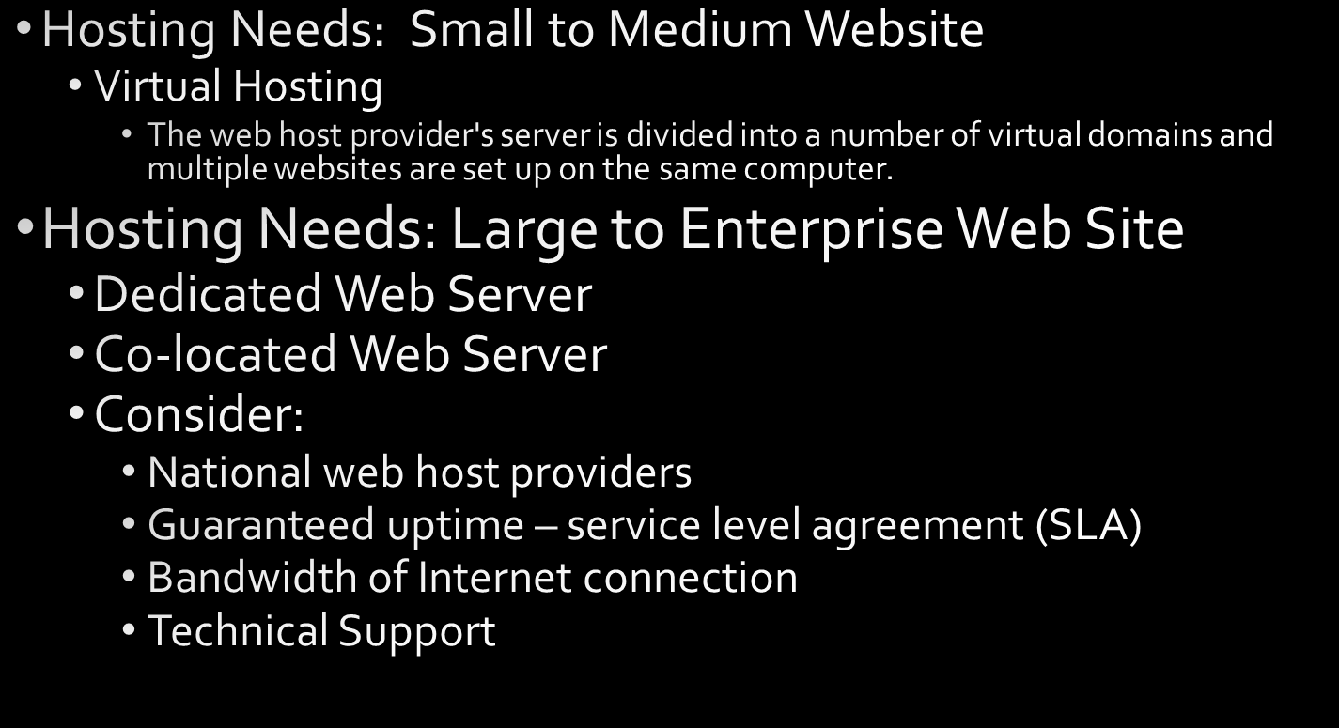
Types of Web Hosting
Copyright © 2016 Pearson Education, Inc., Hoboken NJ

Slide 8

Choosing a Virtual Host
Operating System
Web Server Software
Bandwidth
Technical Support
Service Agreement
Disk Space
E-mail
Uploading Files
Canned Scripts
Scripting Support
Database Support
E-Commerce Packages
Scalability
Backups
Site Statistics
Domain Name
Price
Copyright © 2016 Pearson Education, Inc., Hoboken NJ

Slide 9


Copyright © 2016 Pearson Education, Inc., Hoboken NJ

Slide 10
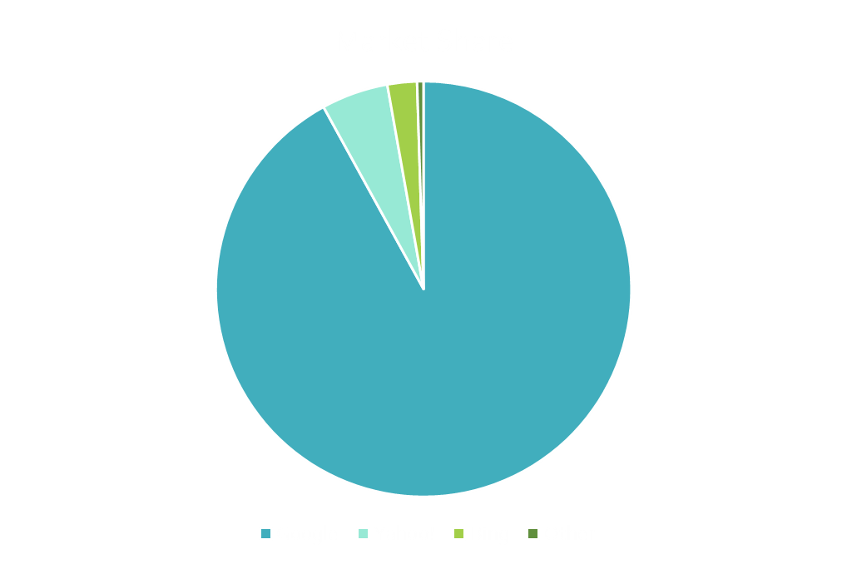


Popular Search Engines
Source: http://marketshare.hitslink.com/search-engine-market-share.aspx
Copyright © 2016 Pearson Education, Inc., Hoboken NJ

Slide 11
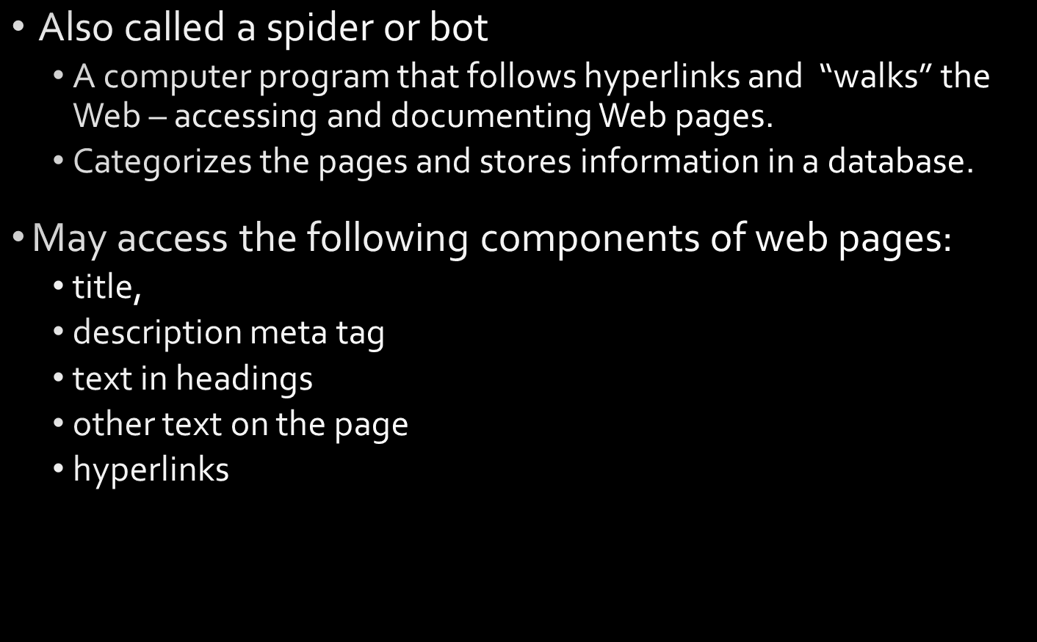
Search Engine Robot
Copyright © 2016 Pearson Education, Inc., Hoboken NJ

Slide 12

Search Engine Database
Copyright © 2016 Pearson Education, Inc., Hoboken NJ

Slide 13
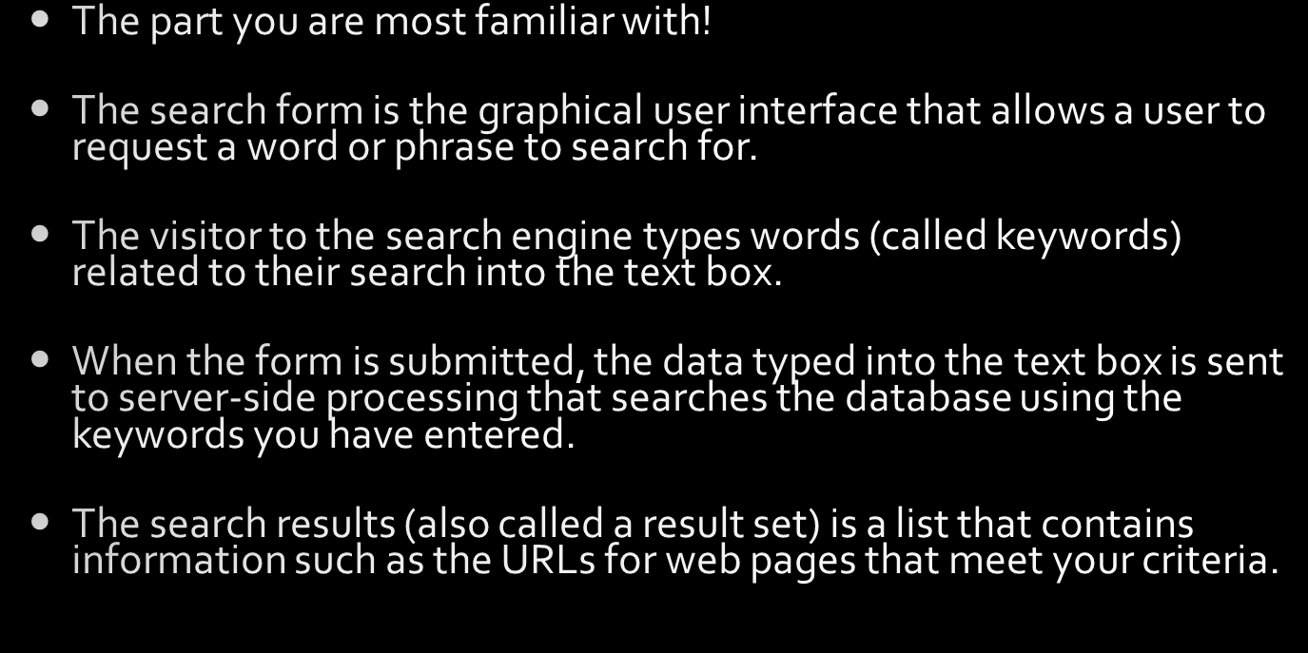
Search Engine
Search Form
Copyright © 2016 Pearson Education, Inc., Hoboken NJ

Slide 14
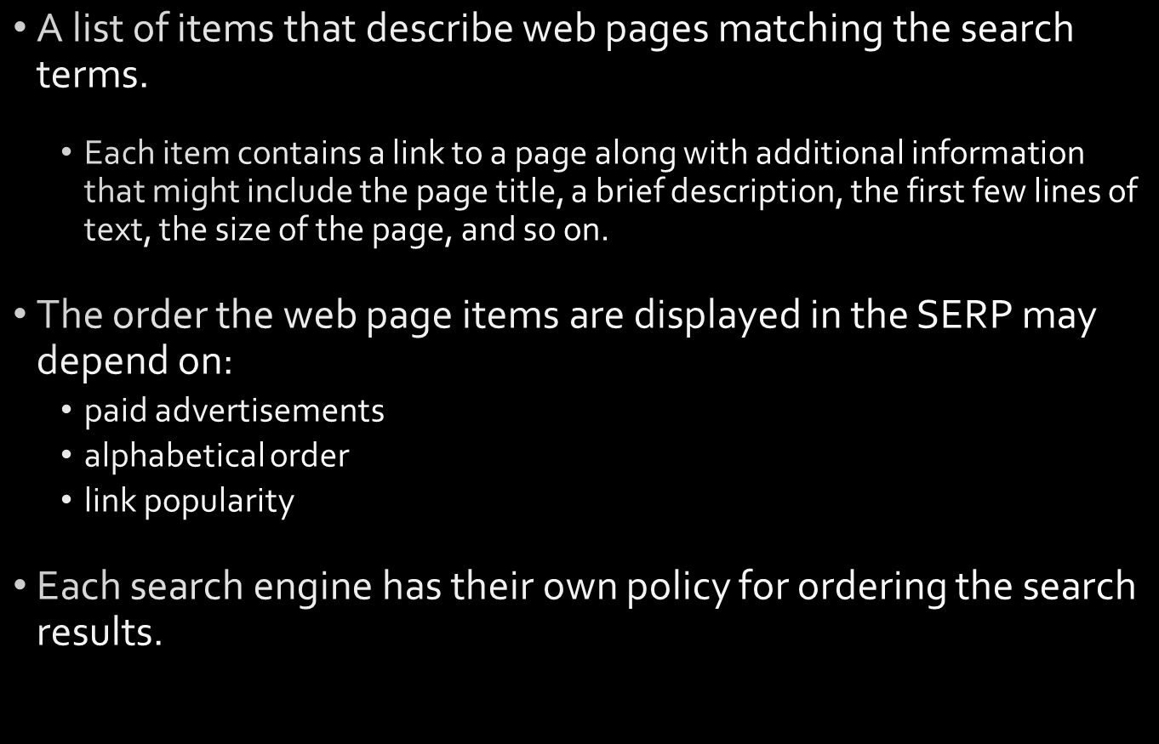
Search Engine Results Page (SERP)
Copyright © 2016 Pearson Education, Inc., Hoboken NJ

Slide 15
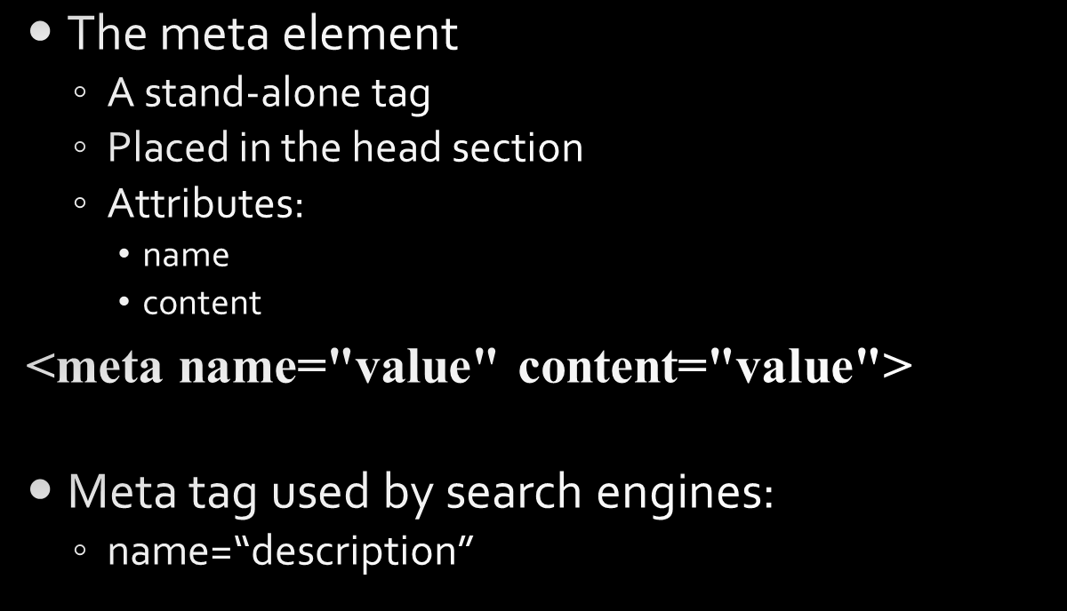
The Meta Element
<meta>
Copyright © 2016 Pearson Education, Inc., Hoboken NJ

Slide 16
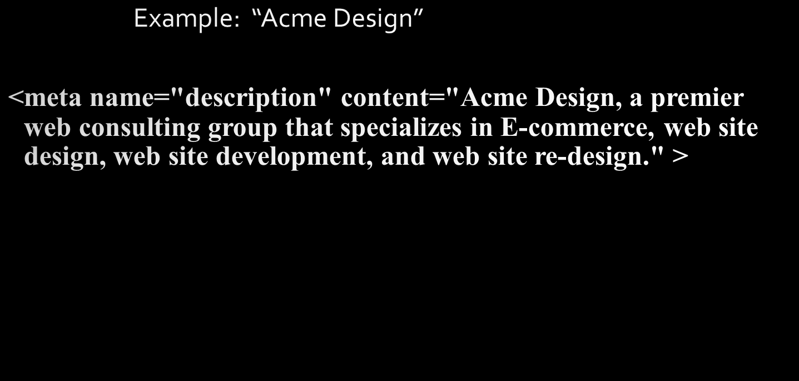
Keywords Meta Tag
Copyright © 2016 Pearson Education, Inc., Hoboken NJ

Slide 17
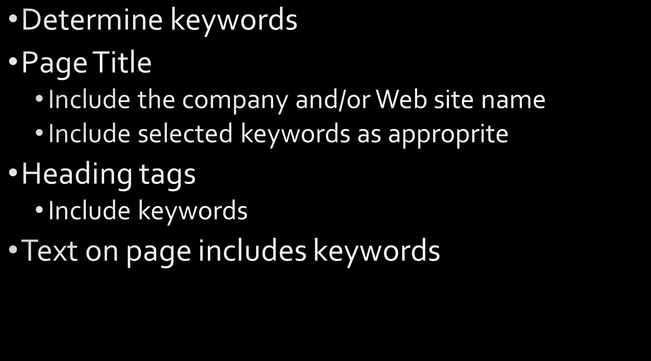

Search Engine Optimization (SEO)
Copyright © 2016 Pearson Education, Inc., Hoboken NJ

Slide 18
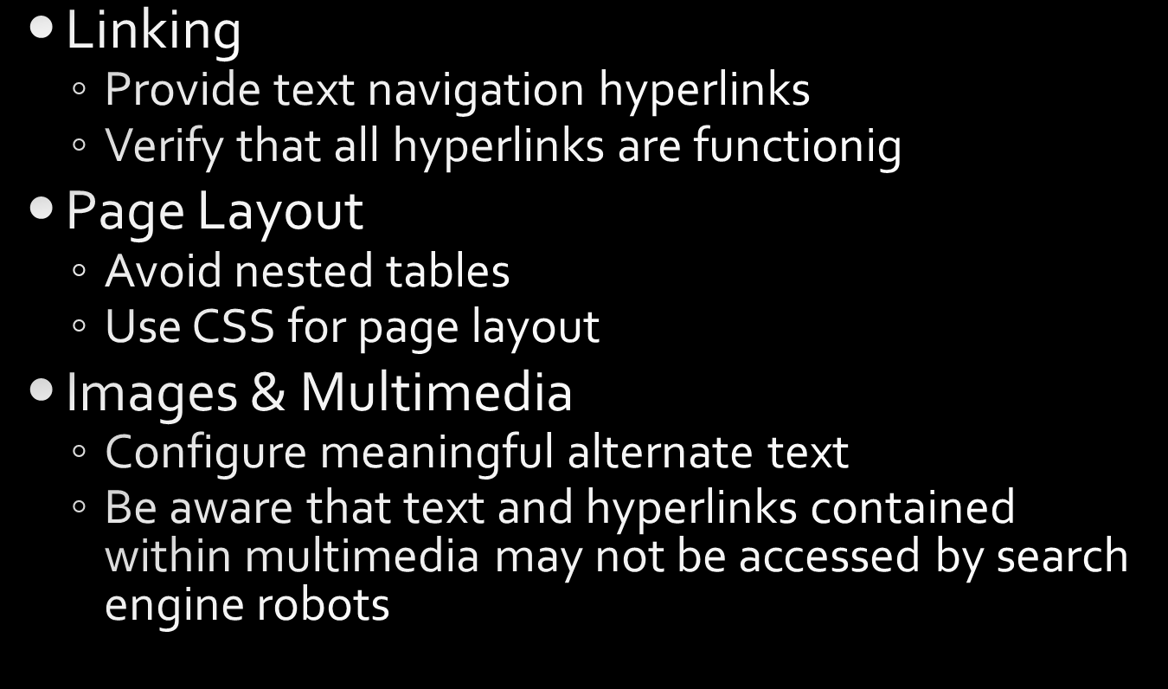

Search Engine Optimization (SEO) 2
Copyright © 2016 Pearson Education, Inc., Hoboken NJ

Slide 19


Search Engine Optimization (SEO) 3
Copyright © 2016 Pearson Education, Inc., Hoboken NJ

Slide 20
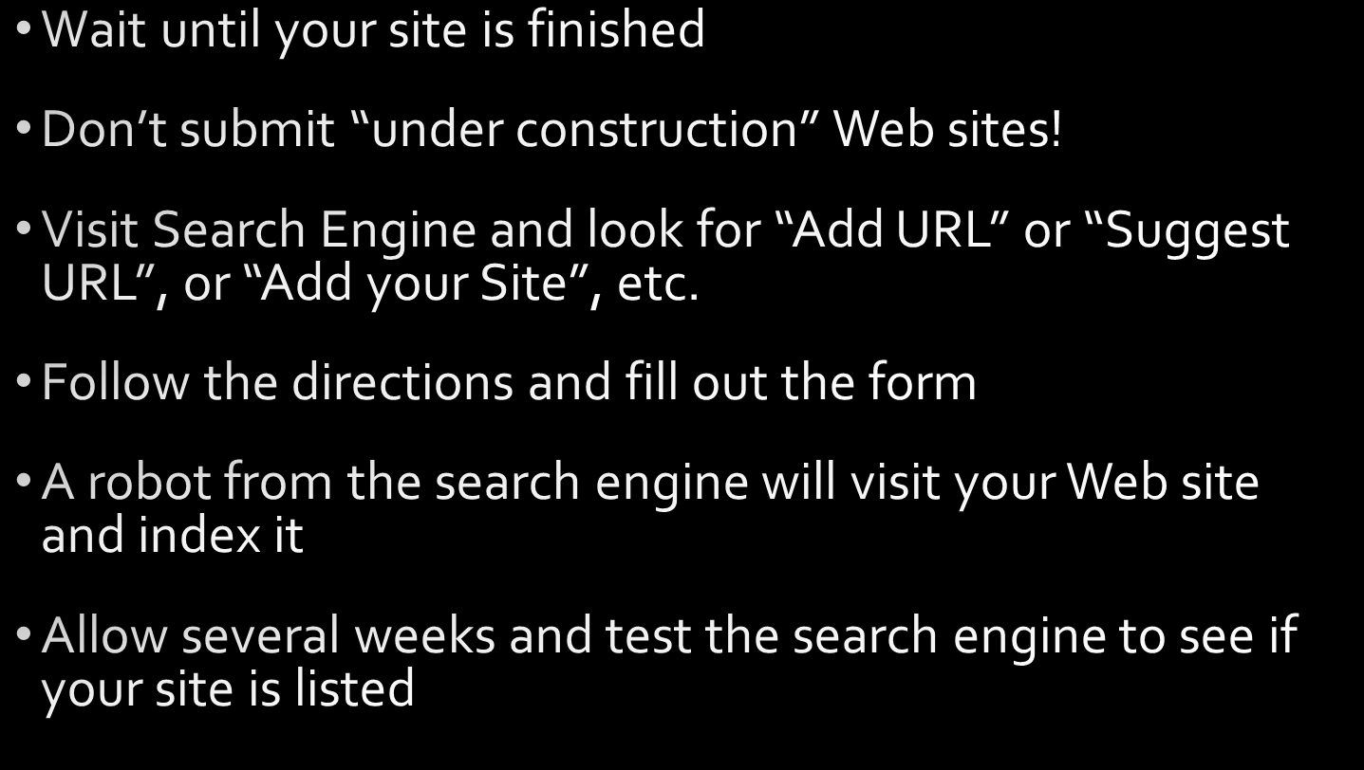
Listing in a Search Engine
Copyright © 2016 Pearson Education, Inc., Hoboken NJ

Slide 21

Link Popularity
Copyright © 2016 Pearson Education, Inc., Hoboken NJ

Slide 22

Accessibility Testing
Copyright © 2016 Pearson Education, Inc., Hoboken NJ

Slide 23

Usability Testing
Copyright © 2016 Pearson Education, Inc., Hoboken NJ

Slide 24

Summary
Copyright © 2016 Pearson Education, Inc., Hoboken NJ

